Slide 1
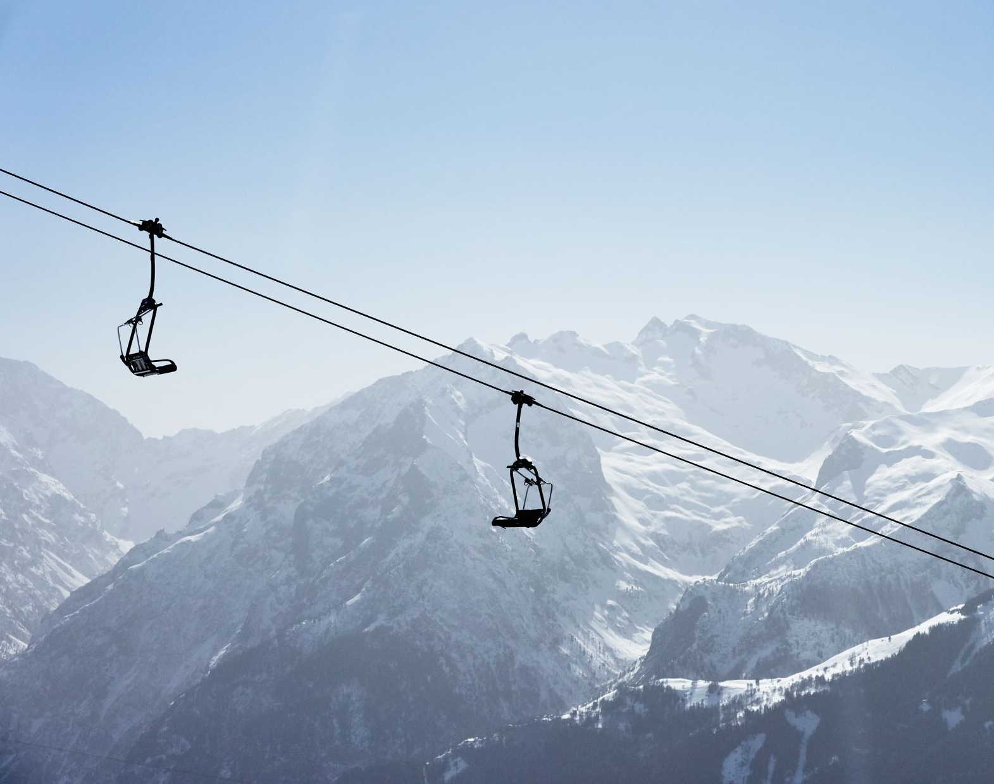
Big Mountain Resort

Slide 2
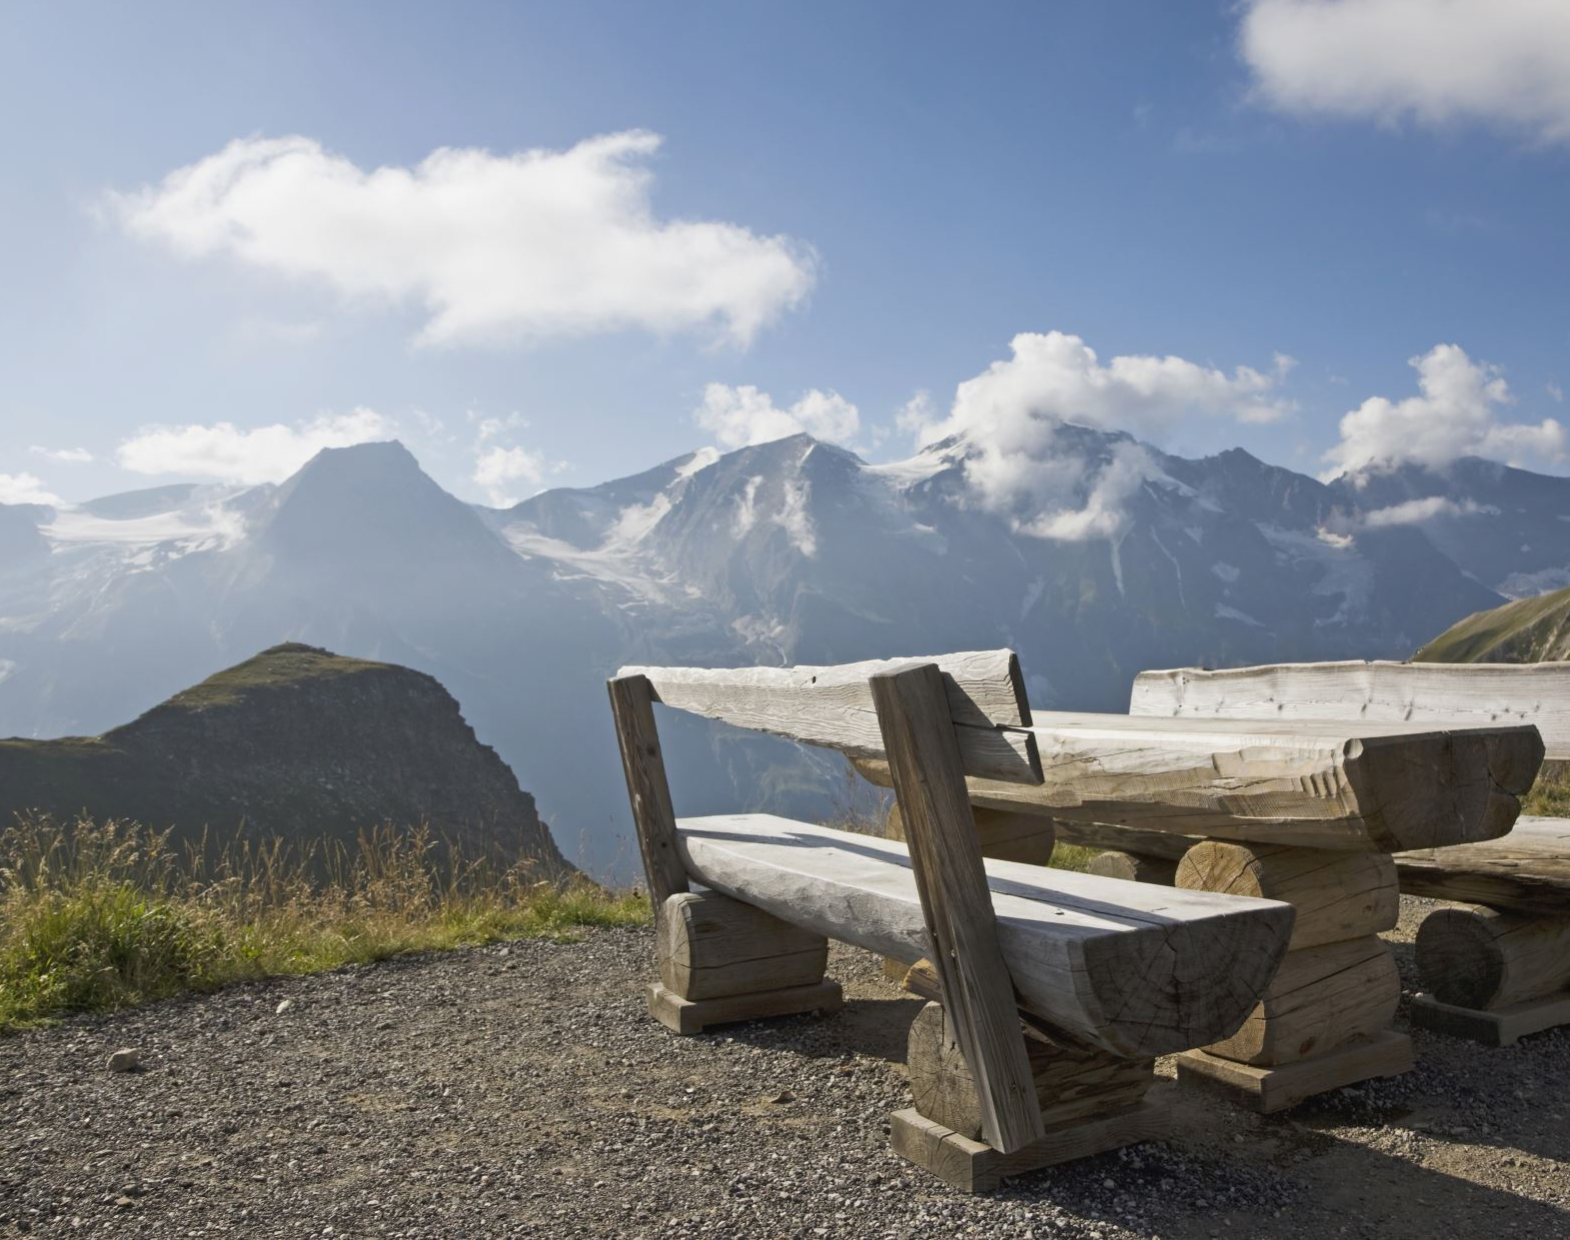
Problem Identification
Big Mountain Resort is a resort replete with many top facilities, leading in many categories.
Thus, to reflect more to its actual value, the resort is planning to expand itself by installing additional chairs.
This installation will cost Big Mountain Resort over $1.53 million over one season
To offset this cost, 4 scenarios were considered.

Slide 3
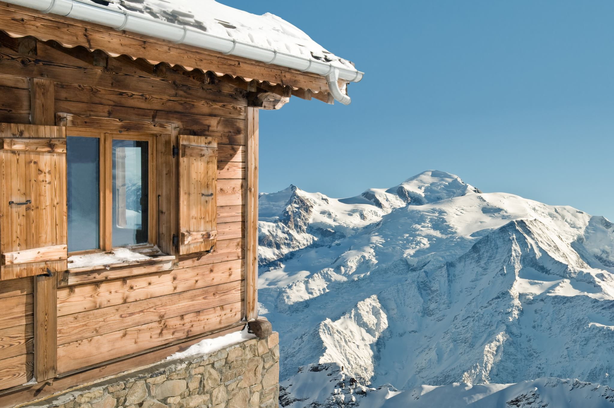
Recommendations
Scenario 2
Solution
Scneario1
We recommend a combination of the first and second scenarios.
The combination will bring the revenue that reflects the proper value of the Big Mountain Resort.

Slide 4
Recommendations
Increase vertical drop by 150 feet and additional chairs could support ticket price increase of $2.07.
This change would increase the revenue by about $3.62 million per season
In addition, with current facility the resort should be able to charge around $93.93.
Close five lanes that are being used the least. Bring down ticket costs at most efficient rate.

Slide 5
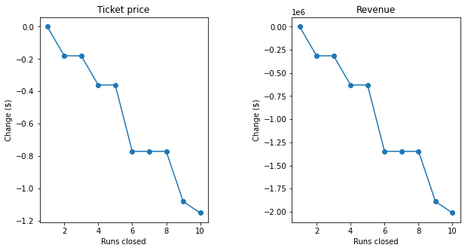
Modeling
If Big Mountain closes two lanes, the overall ticket prices would go down by about 20 cents.
The effect of closing three lanes on equals to about 40 cents.
Therefore, closing five lanes would be the most prudent in this case.
When looking at six lanes or more being closed equals around 80 cents per ticket. Thus, it might be too drastic.

Slide 6
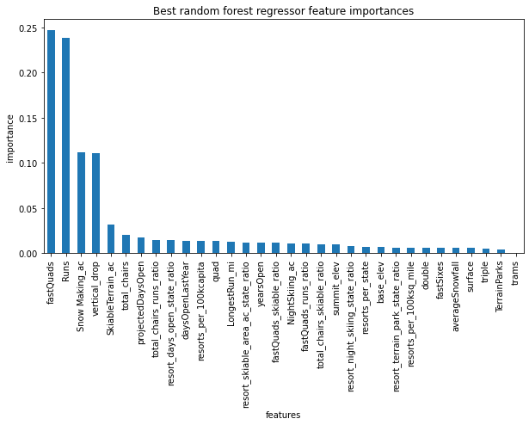
Modeling
The most important facilities are fastQuad shits, runs, snow making area, and vertical drops.
Additional expansions of these features should help support ticket price increases.

Slide 7
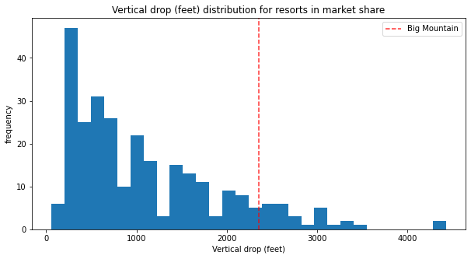
Room for growth
There are resorts that have more vertical drop than Big Mountain Resort.
Thus, increasing vertical drop could help compete with other resorts.

Slide 8
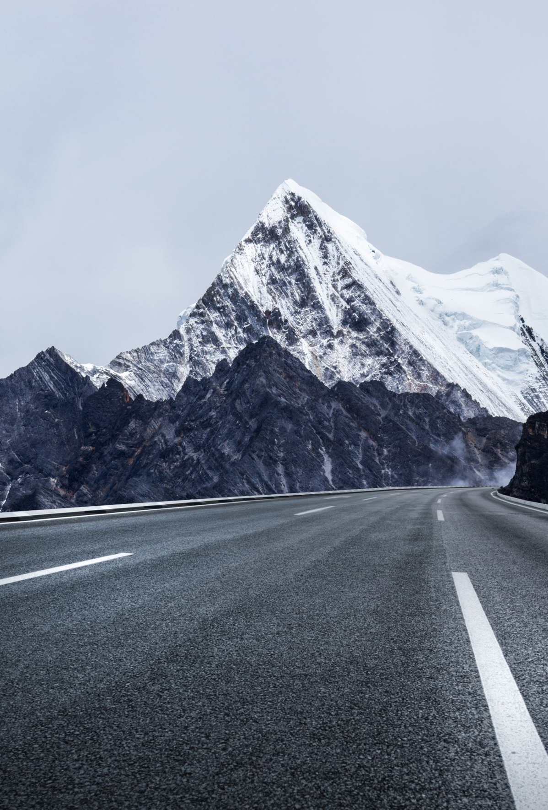
Summary and Conclusion
Big Mount Resort has the capacity to increase ticket prices.
For recommendation, increase the ticket price to match its potential, around $93.98.
Increase vertical drop by 150 feet with additional chairs. This would increase ticket prices to about $2.07.
Close at least five lanes to bring down the operating costs in the most efficient way.
If around five lanes were closed, it would support 40 cents decrease in ticket prices.

